Slide 1


HR Analytical Tool to mitigate employee turnover
March 2023

Slide 2






The Team
Amr
Maraqa
Konstantin
Volodin
Oscar
Montemayor
Utkarsh
Pal
Ximena
Rodríguez

Slide 3



The Problem: Employee turnover
The company's most important asset is its workforce; measuring and tracking employee turnover is essential to identify employee satisfaction
Costs of employee turnover
Attrition rate in United States
Productivity
Loss of human capital, operational disruption, increase workload, negative image of the company…
It costs an employer an average of 33% of an employee’s yearly salary for their exit
Money
Replacement and recruiting costs include advertising, interviewing, selection and placement costs…
Time
Training time, orientational costs, recruiting time…

Slide 4





The Solution: HR Analytical Tool
The Team developed an analytical tool to analyze Amazon employee reviews from Glassdoor to make recommendations to minimize the employee turnover. This tool can be adapted to other companies
Pre-Processing
Analysis & Visualization
Lowercase, Remove stopwords, tokenizing & lemmatization
Power BI dashboards to compile and analyze the topic modeling outcomes
1
3
5
Scrapping
2
Topic Modeling &
Sentiment analysis
4
Business Summary
Over 1,000 Amazon reviews in Glassdoor
Executive summary with the most relevant results and the recommendations for the company
For each review, we found the topic related to the Pros & the one related to the Cons

Slide 5
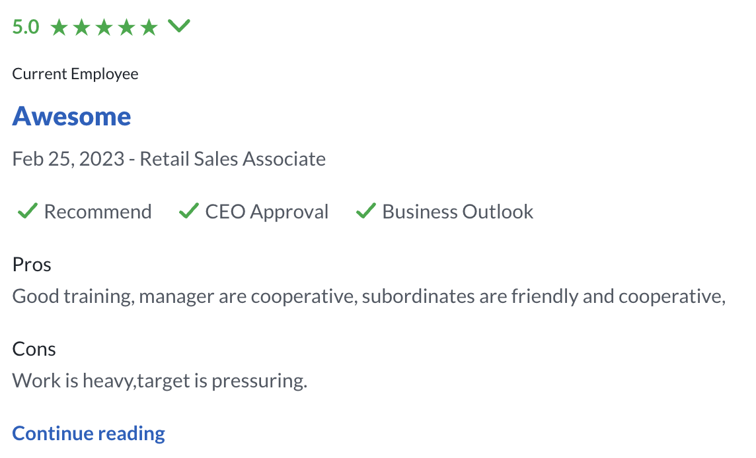
Scrapping and Pre-processing
The Team started scrapping and pre-processing more than 1,000 Amazon reviews in Glassdoor to analyze multiple attributes
Scrapping & Pre-processing
Stars. From 1 to 5
Pre-processing steps
Lowercase
Remove stopwords
Tokenizing
Lemmatization
Employee Seniority
Title review
Location and date
Recommendation, CEO approval & Business outlook
Pros
Cons

Slide 6

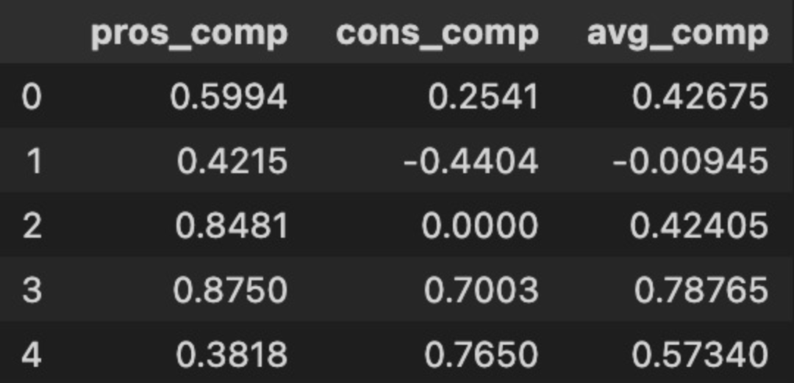
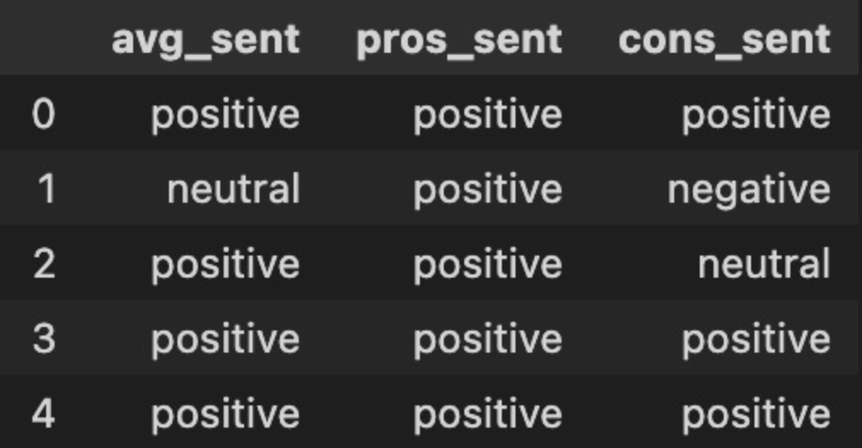
Sentiment Analysis
For Sentiment Analysis, the data had to be pre-processed in a different way. After that, each review was categorized into positive, neutral or negative using vaderSentiment
1
2
Estimate Compound Scores
Assign Sentiment category
For each review, the compound score was calculated for Pros and Cons (-1 extreme negative and 1 extreme positive)
The average compound was calculated to determine the sentiment
Based on the avg_comp, we categorize the reviews in:
Positive: above 0.1
Neutral: between -0.1 and 0.1
Negative: below -0.1
Positive
Neutral
Negative

Slide 7

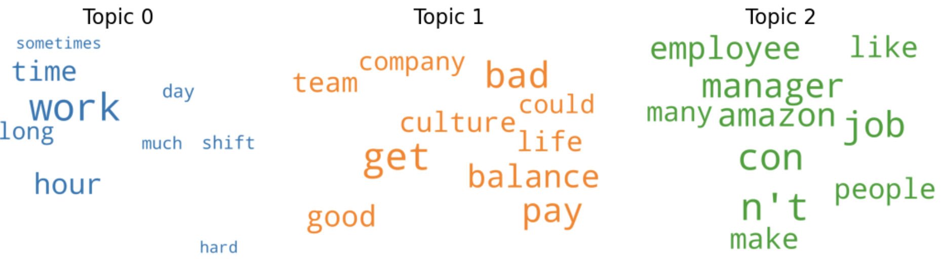
Topic Modeling
For Topic Modeling, the Team used the pre-processed reviews dataset and found the number and characteristics of topics in the Pros and Cons comments using LDA method
Pros comments
Cons comments
Using the topic coherence on Pros comments, the Team found that exist 2 underlying topics in it:
Topic 0. Related to salaries and benefits
Topic 1. Related to opportunities, learn and growth
Using the topic coherence on Cons comments, the Team found that exist 3 underlying topics in it:
Topic 0. Related to work and time
Topic 1. Related to culture and balance
Topic 2. Related to people and manager

Slide 8
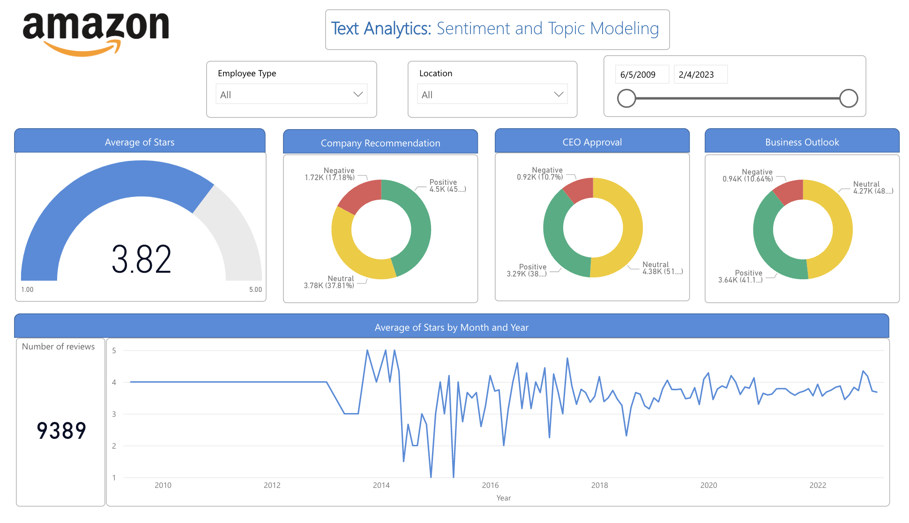
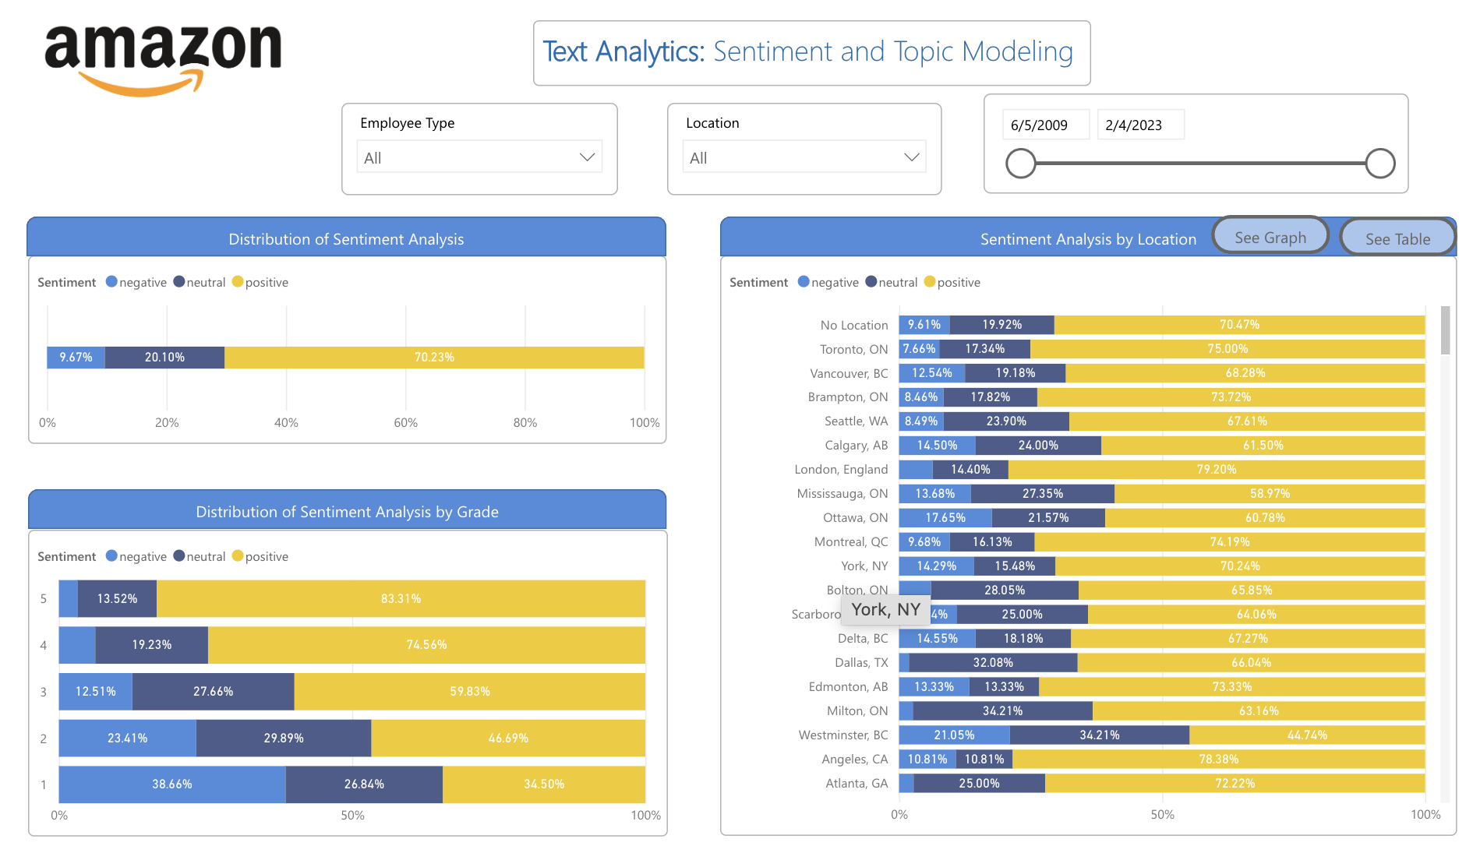
Analysis & Visualization
The team created dashboards in Power BI to analyze, visualize and compile the main results
The HR Analytical Tool can provide relevant insights from Glassdoor reviews and allow the user:
Filter and display information about a specific timeframe, employee type, and location
Visualize the trend and historical performance of Stars by month and year since 2010
Identify sentiment analysis by location to understand which regions are doing well and which poorly
Observe sentiment analysis by employee seniority, among many other insights
Click to see HR Analytical Tool

Slide 9

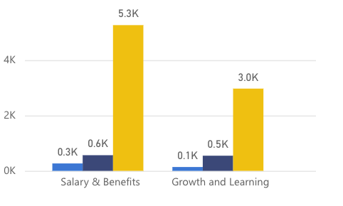
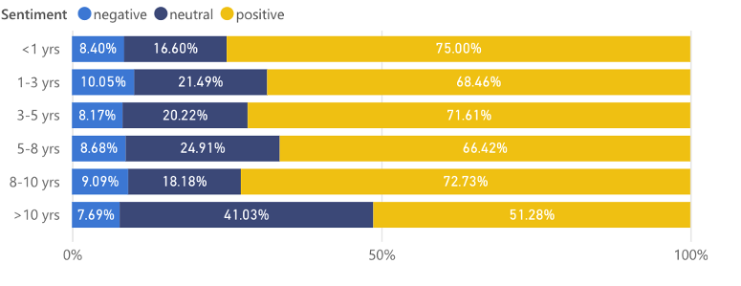
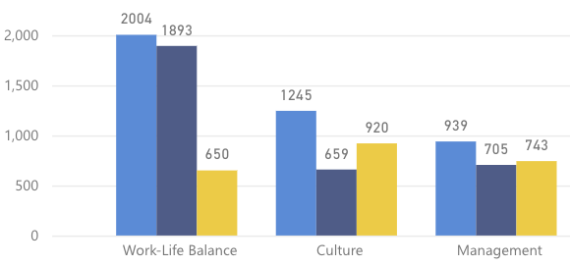
Business Summary
Main results from Sentiment Analysis
Main results from Topic Modeling
From 2018 to 2022, the locations with at least 50 reviews that had the highest and lowest positive reviews were:
From 2018 to 2022:
The topics underlying Pros comments are mainly related to Salaries, and Growth & learning
The topics underlying Cons comments are mainly related to Work-life balance, and Culture
Best performance
1°. London (79%)
2° Toronto (74%)
3° Montreal (74%)
Worst performance
1°. Ottawa (60%)
2° Calgary (61%)
3° Scarborough (64%)
Pros Sentiment
Cons Sentiment
The proportion of positive reviews from employees with more than 10 years in Amazon barely reach 51%

